Slide 1
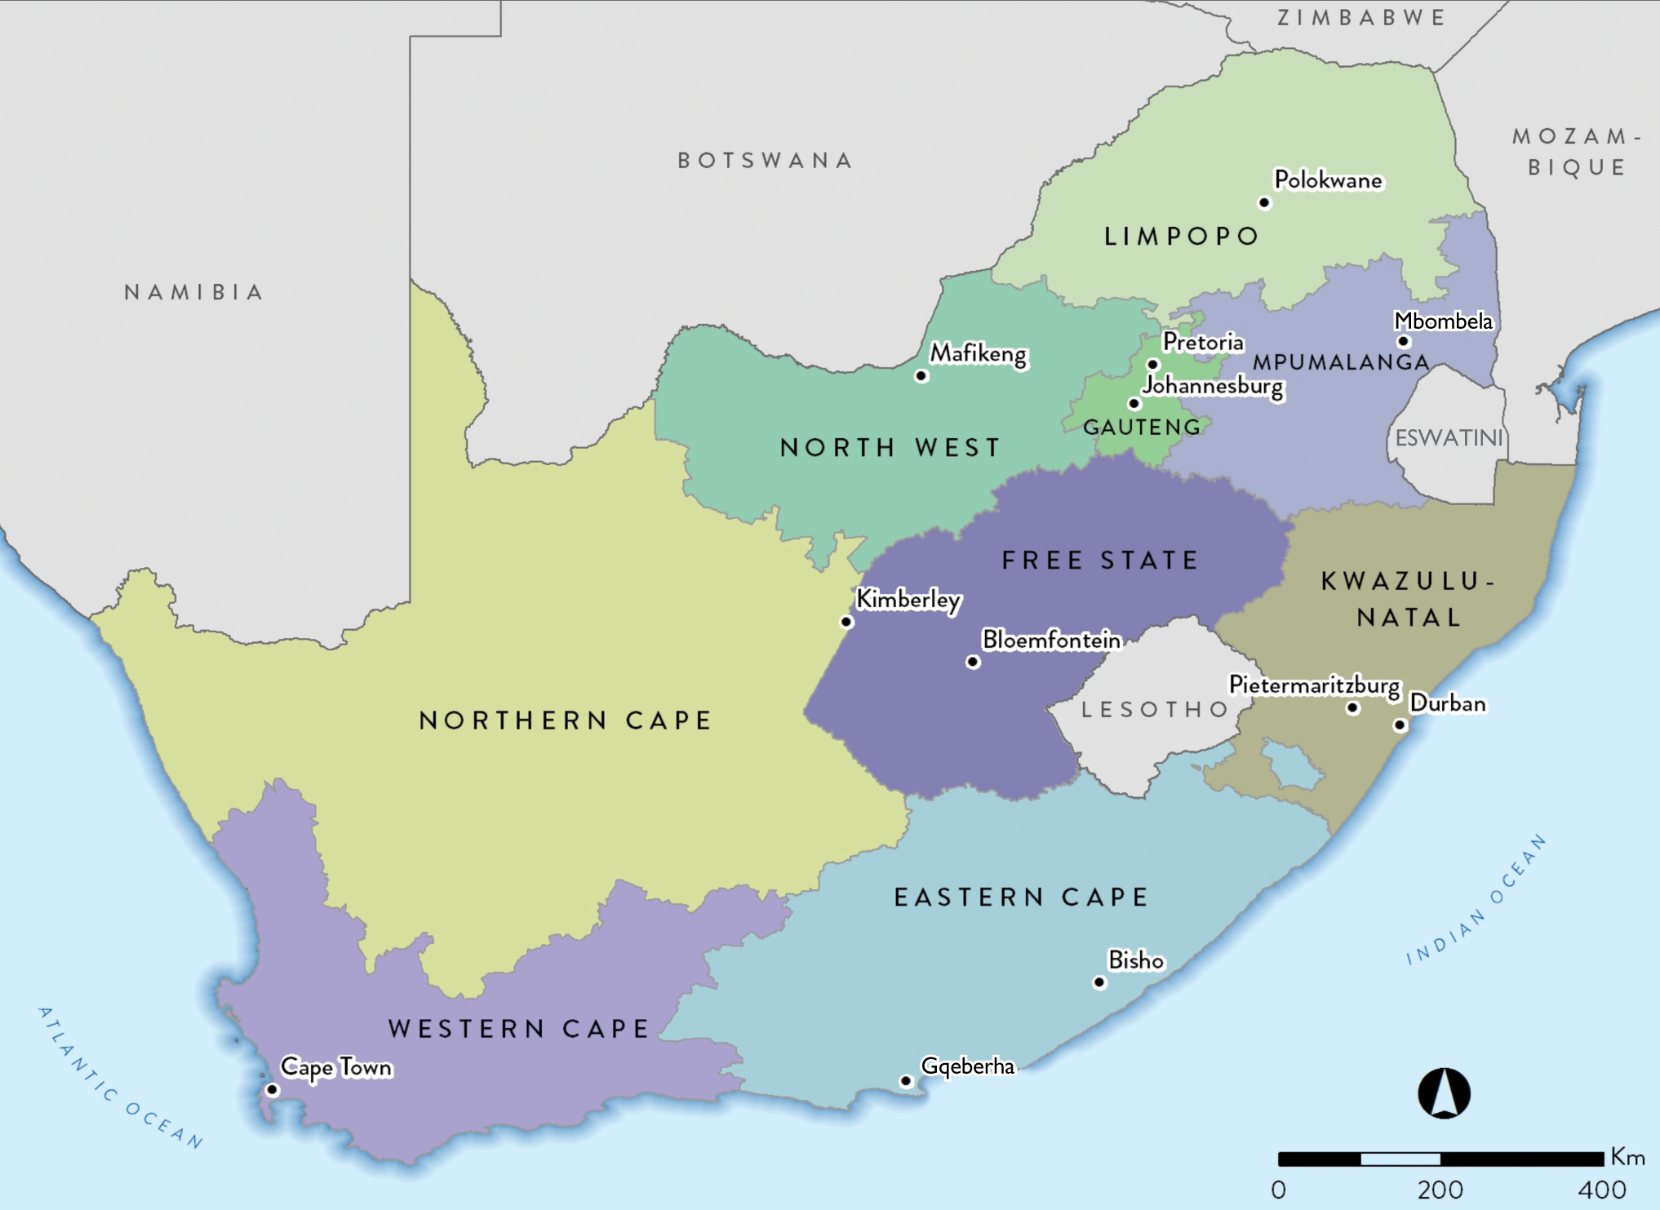
62.03 million

Slide 2
Population data by ethnic group
Population group | Million | %
Black | 50.49 | 81.4
Coloured (mixed ancestry) | 5.05 | 8.2
Indian/Asian | 1.70 | 2.7
White | 4.50 | 7.3
Other | 0.25 | 0.4
Total | 61.99 | 100

Slide 3
Population data by province
Province | Million | %
Eastern Cape | 7.23 | 11.7
Free State | 2.96 | 4.8
Gauteng | 15.10 | 24.3
KwaZulu-Natal | 12.42 | 20.0
Limpopo | 6.57 | 10.6
Mpumalanga | 5.14 | 8.3
North West | 3.80 | 6.1
Northern Cape | 1.36 | 2.2
Western Cape | 7.43 | 12.0
Total | 62.03 | 100.0

Slide 4
Number of treatment centres by province and sector
Sector | EC | FS | GT | KZ | LP | MP | NW | NC | WC | All
Public | 4 | 6 | 7 | 5 | 1 | 0 | 3 | 1 | 5 | 32
Private | 24 | 12 | 77 | 64 | 17 | 12 | 15 | 4 | 36 | 261
Total | 28 | 18 | 84 | 69 | 18 | 12 | 18 | 5 | 41 | 293

Slide 5
Prevalence (pmp) and numbers of patients on KRT by province
Province | EC | FS | GT | KZ | LP | MP | NW | NC | WC | All
Patients | 1 023 | 619 | 2 819 | 1 657 | 358 | 243 | 296 | 169 | 2 158 | 9 342

Slide 6
KRT prevalence (pmp) by healthcare sector
 | Public | Private
Population in millions | 52.99 | 9.03*
Patients on treatment | 2375 | 6967
Treatment rate (pmp) | 45 | 771
*Data supplied by the Council for Medical Schemes

Slide 7
Numbers of patients by province and sector
Sector | EC | FS | GT | KZ | LP | MP | NW | NC | WC | All
Public | 272 | 294 | 481 | 138 | 66 | 14 | 43 | 70 | 997 | 2 375
Private | 751 | 325 | 2 338 | 1 519 | 292 | 229 | 253 | 99 | 1 161 | 6 967
Total | 1 023 | 619 | 2 819 | 1 657 | 358 | 243 | 296 | 169 | 2 158 | 9 342

Slide 8
KRT prevalence (pmp) by province and sector
Notes:
Adjusted for unclassified medical aid beneficiaries

Slide 9
Distribution of patients by treatment modality
Modality | Patients | %
Haemodialysis | 6 702 | 71.7
Peritoneal dialysis | 911 | 9.8
Transplant | 1 729 | 18.5

Slide 10
KRT modality by sector
Public
11.3%
Private
4.7%
39.8%
35.7%
84.0%
24.6%
Treatment modality | Public sector |  | Private sector
 | Patients | % | Patients | %
Haemodialysis | 847 | 35.7 | 5 855 | 84.0
Peritoneal dialysis | 583 | 24.6 | 328 | 4.7
Transplant | 945 | 39.8 | 784 | 11.3

Slide 11
KRT patient numbers and prevalence by ethnicity
Prevalence per million population

Slide 12
Most commonly reported causes of kidney failure
 | % of total
Hypertensive kidney disease | 39.0
Cause unknown | 30.5
Diabetic nephropathy | 12.8
Glomerular disease | 10.4
Cystic kidney disease | 3.0
Obstruction and reflux | 1.6

