Slide 1
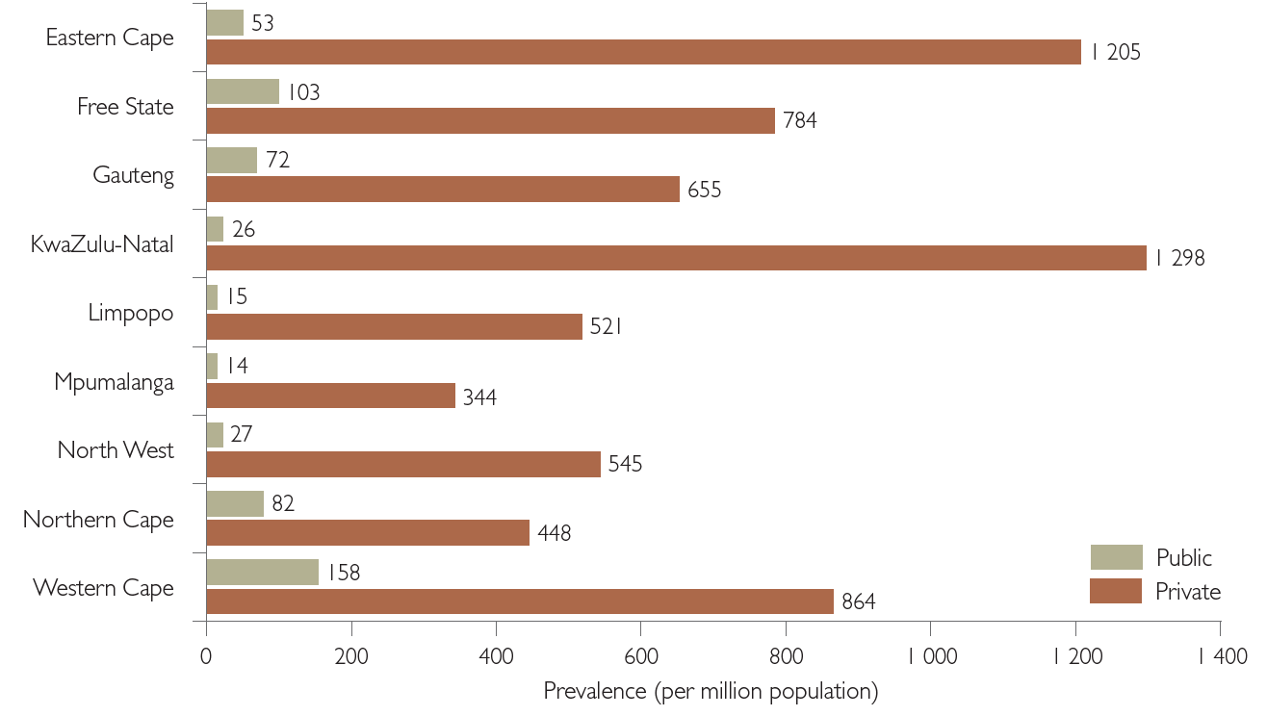
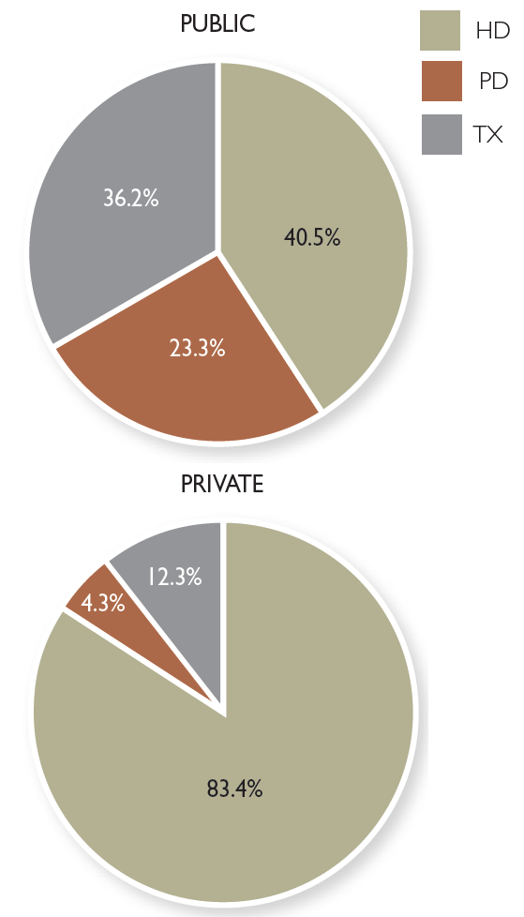
South African Renal Registry Annual Report 2019 MR Davids, T Jardine, N Marais, S Sebastian, T Davids, JC Jacobs
Background The eighth annual report of the South African Renal Registry summarises the 2019 data on kidney replacement therapy (KRT) for patients with kidney failure in South Africa.
Figure 2. Kidney replacement therapy prevalence by province and sector.
Methods Data capturers interface with the central database via user-friendly web pages from any device that has internet access. Survival data are cross-checked by linking to the Department of Home Affairs database of births and deaths.
Results In December 2019, 9 937 patients were being treated with chronic dialysis or transplantation, a prevalence of 169 per million popul-ation (pmp). This overall rate masks a difference of 788 pmp in the private sector and 57 pmp in the public sector, still below the rate reported for 1994.
The data presented in this report must be interpreted with due consideration of the challenges presented by the COVID-19 pandemic.
Figure 1. Treatment modality by sector
Conclusion The treatment rates in the public sector remain extremely low in 2019. The Western Cape had the highest public sector treatment rates by a large margin.
Afr J Nephrol. 2021; 24 (1): 95-106
DOI: 10.21804/24-1-4980

