Slide 1
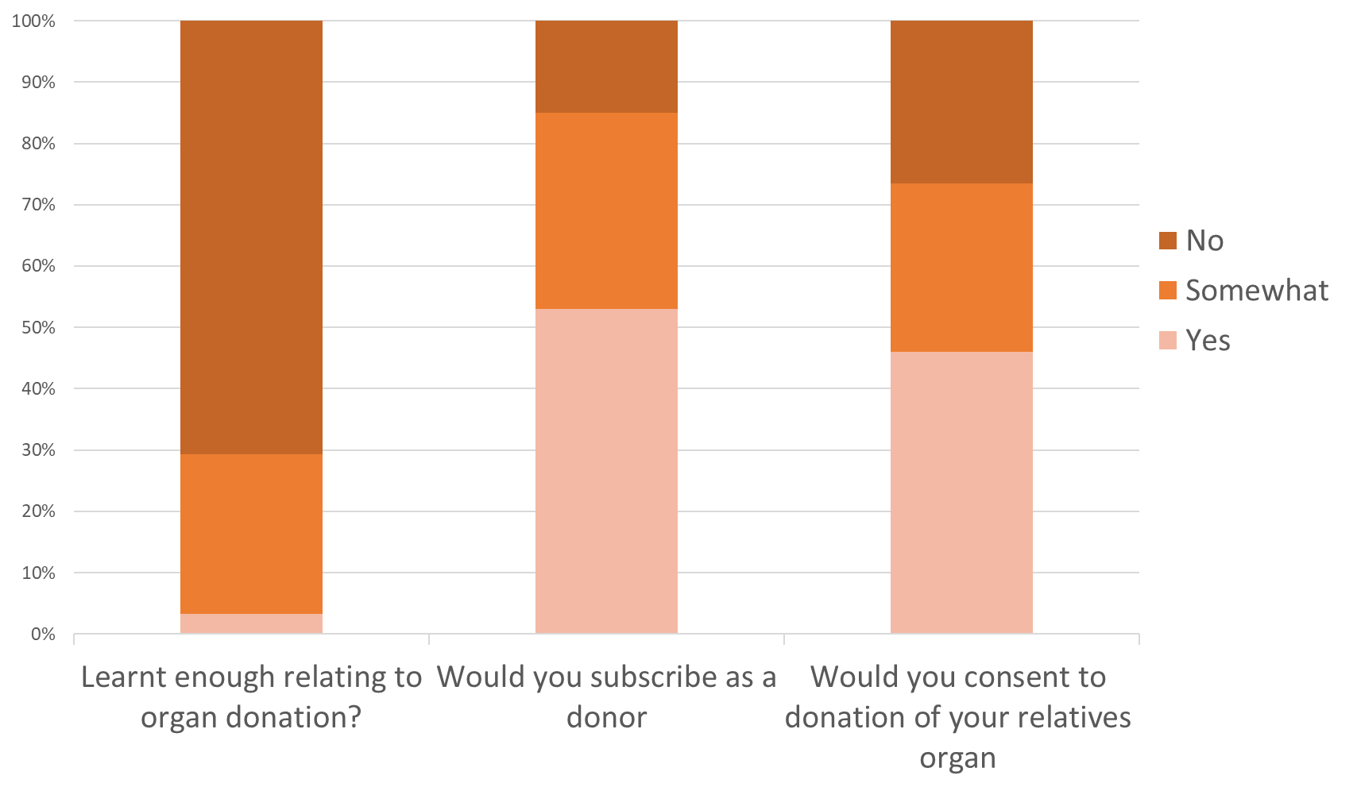
Knowledge and attitudes of undergraduate medical students in Kenya towards solid organ donation and transplantation: Are Africa’s future clinicians prepared? N.M. Mpekethu, N.B. Mongare, V. Mutua, M. Wangari, C. von Csefalvay, D. Ojuka.
Background Solid organ donation and transplantation remains grossly underdeveloped in most African countries. The knowledge and attitude of tomorrow’s professionals may be key to the improvement of these services.
were comfortable introducing the topic or confident answering questions (23%) related to organ donation and transplantation. Only 9.9% of the sample had ever spoken to a patient about organ donation.
Methods A sample of undergraduate medical students from all the medical schools in Kenya offering Bachelor of Medicine and Bachelor of Surgery degrees were surveyed using a self-administered, web-based questionnaire, between July and September 2018.
Results Of the 303 participants, 167 (55.1%) were female. Only 8.9% of the students had read the laws governing transplantation in Kenya. An even lower percentage (3.3%) felt that they had learned enough about solid organ donation and transplantation from their medical curriculum. More than half (53%) of the respondents would subscribe as solid organ donors, which reduced to 47% when it came to consenting to donating their relatives’ organs. Less than half of the students (40%)
Conclusion Undergraduate medical students have significant knowledge gaps regarding organ donation and transplantation and feel ill-prepared to approach a potential donor or transplant recipient.
Afr J Nephrol. 2021; 24 (1):89-94
DOI: https://doi.org/10.21804/24-1-4843

