Slide 1
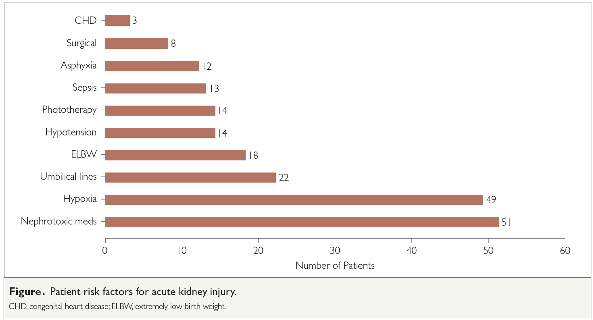
An observational study of acute kidney injury in critically ill neonates at Chris Hani Baragwanath Academic Hospital, South Africa Sanelisiwe B Z Balfour, Letlhogonolo Sepeng, Karen L Petersen
Background Acute kidney injury (AKI) is common in critically ill, hospitalised neonates. This study aimed to determine the incidence and outcomes of AKI in critically ill neonates in South Africa.
catheterisation (OR 6.3, p = 0.01), sepsis (OR 5.4, p = 0.01), phototherapy (OR 4.4, p = 0.03) and prematurity (p = 0.04). The most frequent risk factor associated with AKI was intravenous nephrotoxic medication.
Methods This single-centre, prospective, observational study was conducted in the neonatal unit of the Chris Hani Baragwanath Academic Hospital, a tertiary-level hospital in Johannesburg, South Africa. Neonates with AKI, defined using the AKI Network criteria, were recruited over a three-month period in 2019. Risk factors and demographic data were collected for all study participants, who were followed up over the period to observe an outcome of either recovery or death.
Results
Fifty-one cases of AKI were identified, representing 7.8% of all admissions (95% CI 5.9–10.2%). The overall mortality of enrolled patients was 29.4% (95% CI 26.3–56.1%). Mortality was significantly associated with extremely low birth weight (OR 11.4, p < 0.01), umbilical
Conclusion The incidence of AKI in our study was higher than expected. Further epidemiological and interventional studies are warranted to identify and improve the long-term outcome of AKI in the newborn in our setting.
Afr J Nephrol. 2021; 24 (1): 51-57
DOI: https://doi.org/10.21804/24-1-4682

