Slide 1
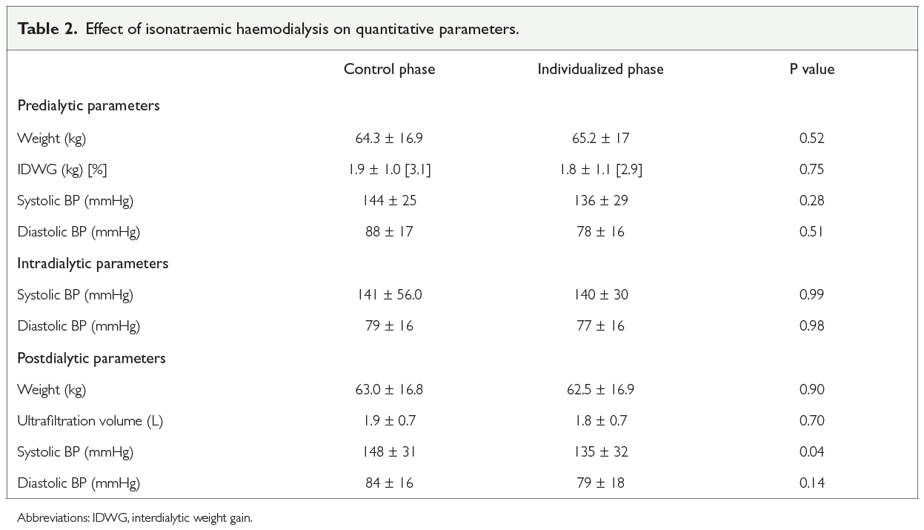
Isonatraemic haemodialysis in the management of salt and water overload: a crossover trial at an academic hospital in Dakar, Senegal Faye M, Ba B, Keita N, Ba SM, Coulibaly CAT, Thioune I, et al.
Aim
To assess the impact of isonatraemic haemodialysis on reduction of interdialytic weight gain (IDWG) and blood pressure (BP) as well as its tolerability in our study population.
Postdialytic systolic blood pressure (BP) was lower during the individualized phase (P = 0.04). Apart from headaches, which were more common in the individualized phase (P = 0.04), isonatraemic haemodialysis was well tolerated.
Methods
Crossover trial conducted on 32 patients stable on chronic haemodialysis. In the initial “control phase”, patients had nine haemodialysis sessions with a dialysate sodium (Na+) concentration (Na+ dialysate) of 138 mmol/L. The serum Na+ set point (SP) for each patient was calculated from three predialytic mid-week values. In the second phase, the “individualized phase”, patients had nine dialysis sessions with Na+ dialysate equal to their SP.
Results
The mean age of the patients was 55.5 ± 12.1 years, with a male/female ratio of 1.3 and the most common cause of kidney disease was hypertension (47%).
Conclusion
IDWG as well as pre- and intradialytic BP were unaffected by isonatraemic haemodialysis. Postdialytic BP was significantly reduced.
Afr J Nephrol. 2021; 24 (1): 25 - 30
DOI: https://doi.org/10.21804/24-1-4484

