Slide 1
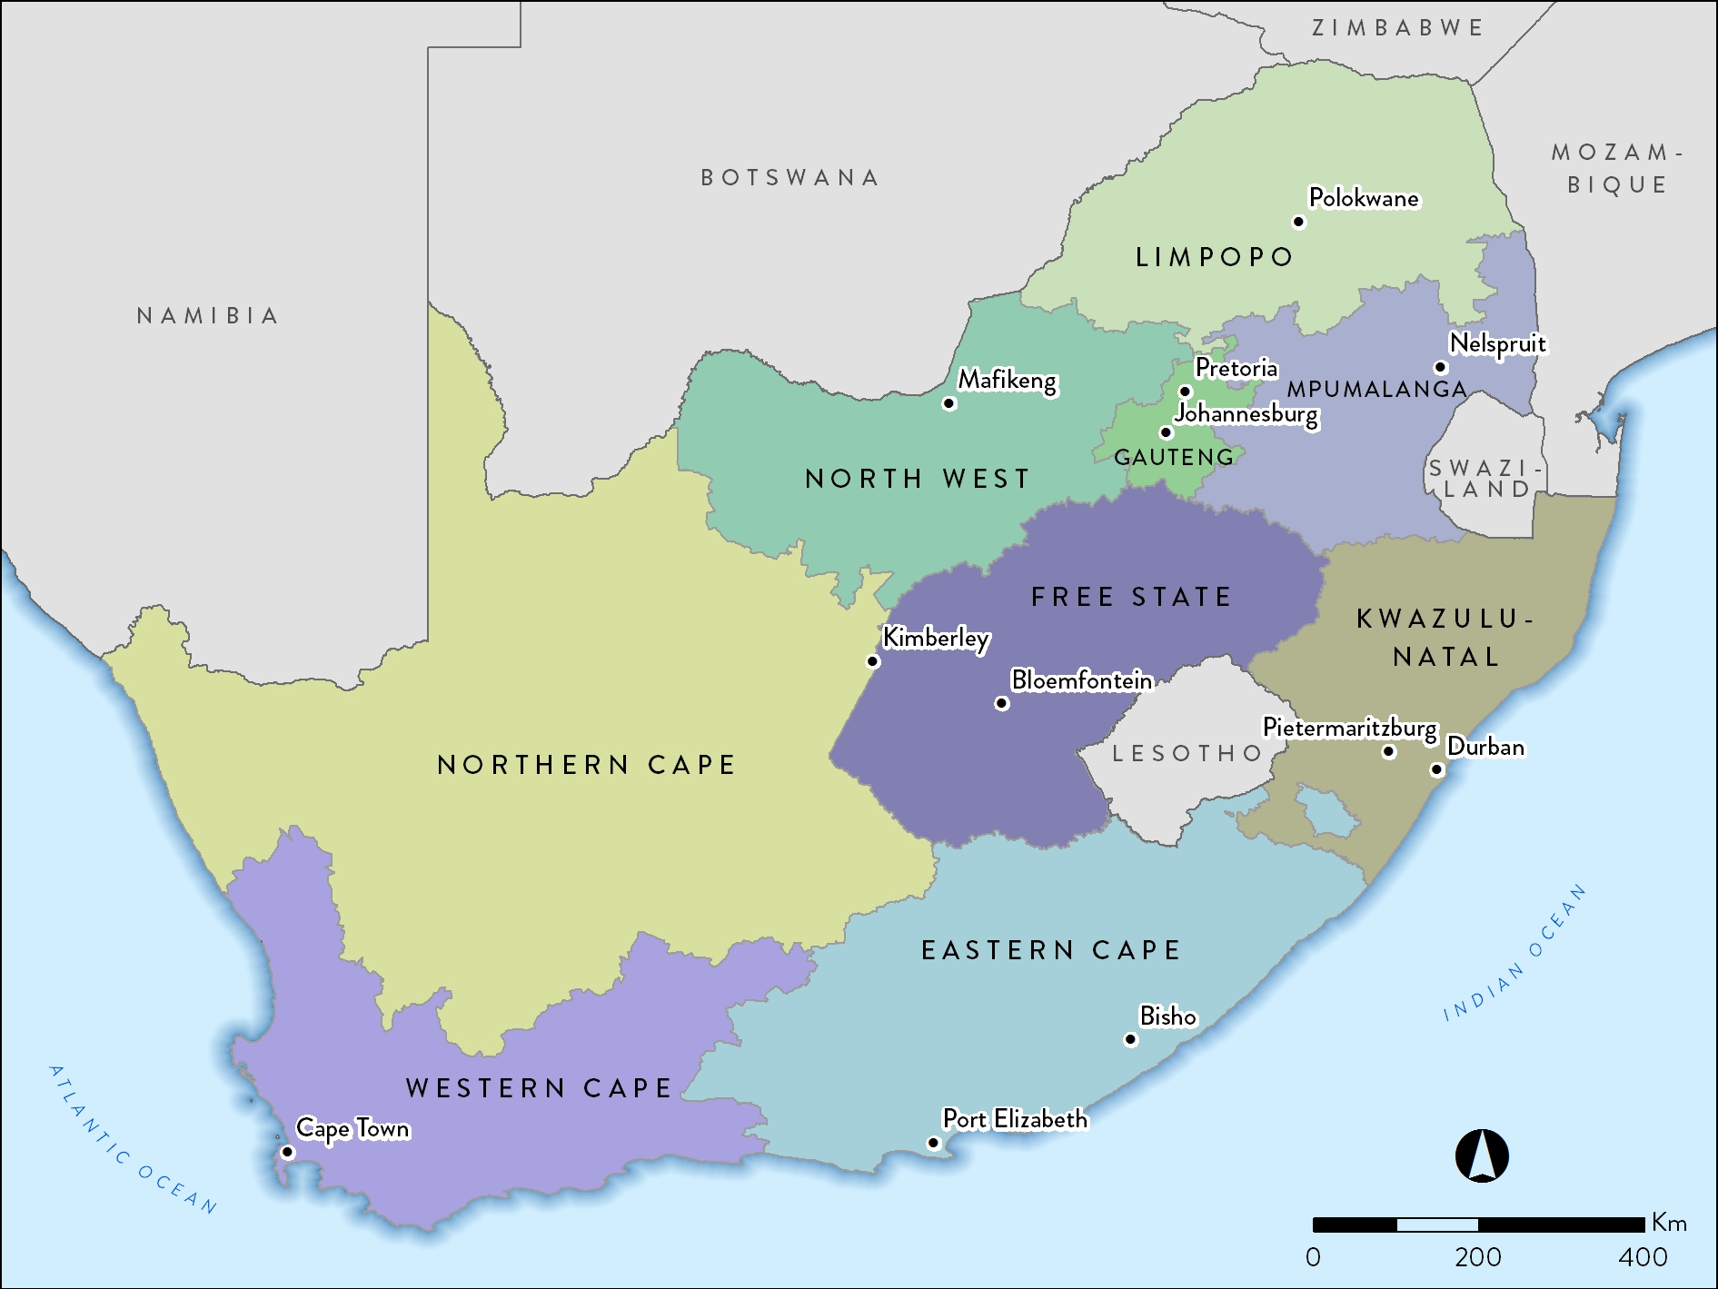
56.52 million

Slide 2
Population data by province
Province | Million | %
Eastern Cape (EC) | 6.50 | 11.5
Free State (FS) | 2.87 | 5.1
Gauteng (GT) | 14.28 | 25.3
KwaZulu-Natal (KZN) | 11.07 | 19.6
Limpopo (LP) | 5.78 | 10.2
Mpumalanga (MP) | 4.44 | 7.9
North West (NW) | 3.86 | 6.8
Northern Cape (NC) | 1.21 | 2.1
Western Cape (WC) | 6.51 | 11.5
Total | 56.52 | 100

Slide 3
Population data by ethnic group
Population group | Million | %
Black | 45.65 | 80.8
Coloured (mixed ancestry) | 4.96 | 8.8
White | 4.49 | 8.0
Indian/Asian | 1.41 | 2.5
Total | 56.52 | 100

Slide 4
Number of treatment centres by province and sector
Sector | EC | FS | GT | KZ | LP | MP | NW | NC | WC | All
Public | 3 | 6 | 6 | 5 | 0 | 0 | 3 | 1 | 5 | 29
Private | 19 | 13 | 73 | 69 | 13 | 13 | 12 | 4 | 33 | 249
Total | 22 | 19 | 79 | 74 | 13 | 13 | 15 | 5 | 38 | 278

Slide 5
Prevalence and numbers of patients on RRT by province
Province | EC | FS | GT | KZ | LP | MP | NW | NC | WC | All
Patients | 1 013 | 578 | 3 608 | 2 064 | 391 | 254 | 424 | 129 | 2 283 | 10 744

Slide 6
RRT prevalence by healthcare sector
 | Public | Private
Population in millions | 47.65 | 8.87*
ESRD patients on treatment | 3 162 | 7 582
Treatment rate (pmp) | 66 | 855
* Council for Medical Schemes Annual Report 2017/18

Slide 7
Numbers of patients by province and sector
Sector | EC | FS | GT | KZ | LP | MP | NW | NC | WC | All
Public | 304 | 239 | 1 007 | 326 | 143 | 33 | 150 | 67 | 893 | 3 162
Private | 709 | 339 | 2 601 | 1 738 | 248 | 221 | 274 | 62 | 1 390 | 7 582
Total | 1 013 | 578 | 3 608 | 2 064 | 391 | 254 | 424 | 129 | 2 283 | 10 744

Slide 8
Prevalence of RRT by province and sector
Notes:
Adjusted for unclassified medical aid beneficiaries

Slide 9
Distribution of patients by treatment modality
Modality | Patients | %
Haemodialysis | 7 682 | 71.5
Peritoneal dialysis | 1 199 | 11.2
Transplant | 1 863 | 17.3

Slide 10
RRT modality by sector
Public
10.4%
Private
5.1%
33.1%
40.9%
84.1%
26.0%
Treatment modality | Public sector |  | Private sector
 | Patients | % | Patients | %
Haemodialysis | 1282 | 40.9 | 6400 | 84.1
Peritoneal dialysis | 814 | 26.0 | 385 | 5.1
Transplant | 1038 | 33.1 | 825 | 10.4

Slide 11
New kidney transplants in 2017
 | Deceased donor |  | Living related |  | Living unrelated |  | Total
 | C | A | C | A | C | A
Western Cape - Public | 6 | 32 | 2 | 14 | 0 | 1 | 55
Western Cape - Private | 0 | 13 | 0 | 28 | 0 | 14 | 55
Gauteng - Public | 5 | 25 | 4 | 3 | 0 | 0 | 37
Gauteng - Private | 1 | 36 | 5 | 21 | 0 | 20 | 83
KwaZulu-Natal - Public | 0 | 0 | 1 | 6 | 0 | 0 | 7
KwaZulu-Natal - Private | 0 | 7 | 0 | 6 | 0 | 3 | 16
Free State - Public | 0 | 0 | 0 | 0 | 0 | 0 | 0
Free State - Private | 0 | 4 | 0 | 1 | 0 | 2 | 7
Total | 12 | 117 | 12 | 79 | 0 | 40 | 260
C = child recipient <18 years; A = adult recipient 18 years and older.
The kidney transplant rate for 2017 was 4.6 pmp.
Data supplied by the SA Organ Donor Foundation.

Slide 12
RRT patient numbers and prevalence by ethnicity
Prevalence per million population

Slide 13
Most commonly reported causes of ESRD
 | % of total
Hypertensive renal disease | 35.1
Cause unknown | 31.9
Diabetic nephropathy | 15.3
Glomerular disease | 10.3
Cystic kidney disease | 3.0
Obstruction and reflux | 1.8
Notes:
GN = 3235
HT = 3104
DM = 1273
CYSTIC = 282
UNKNOWN = 1228
OTHER = 331
Genitourinary causes = 138
Total = 9591

