Slide 1
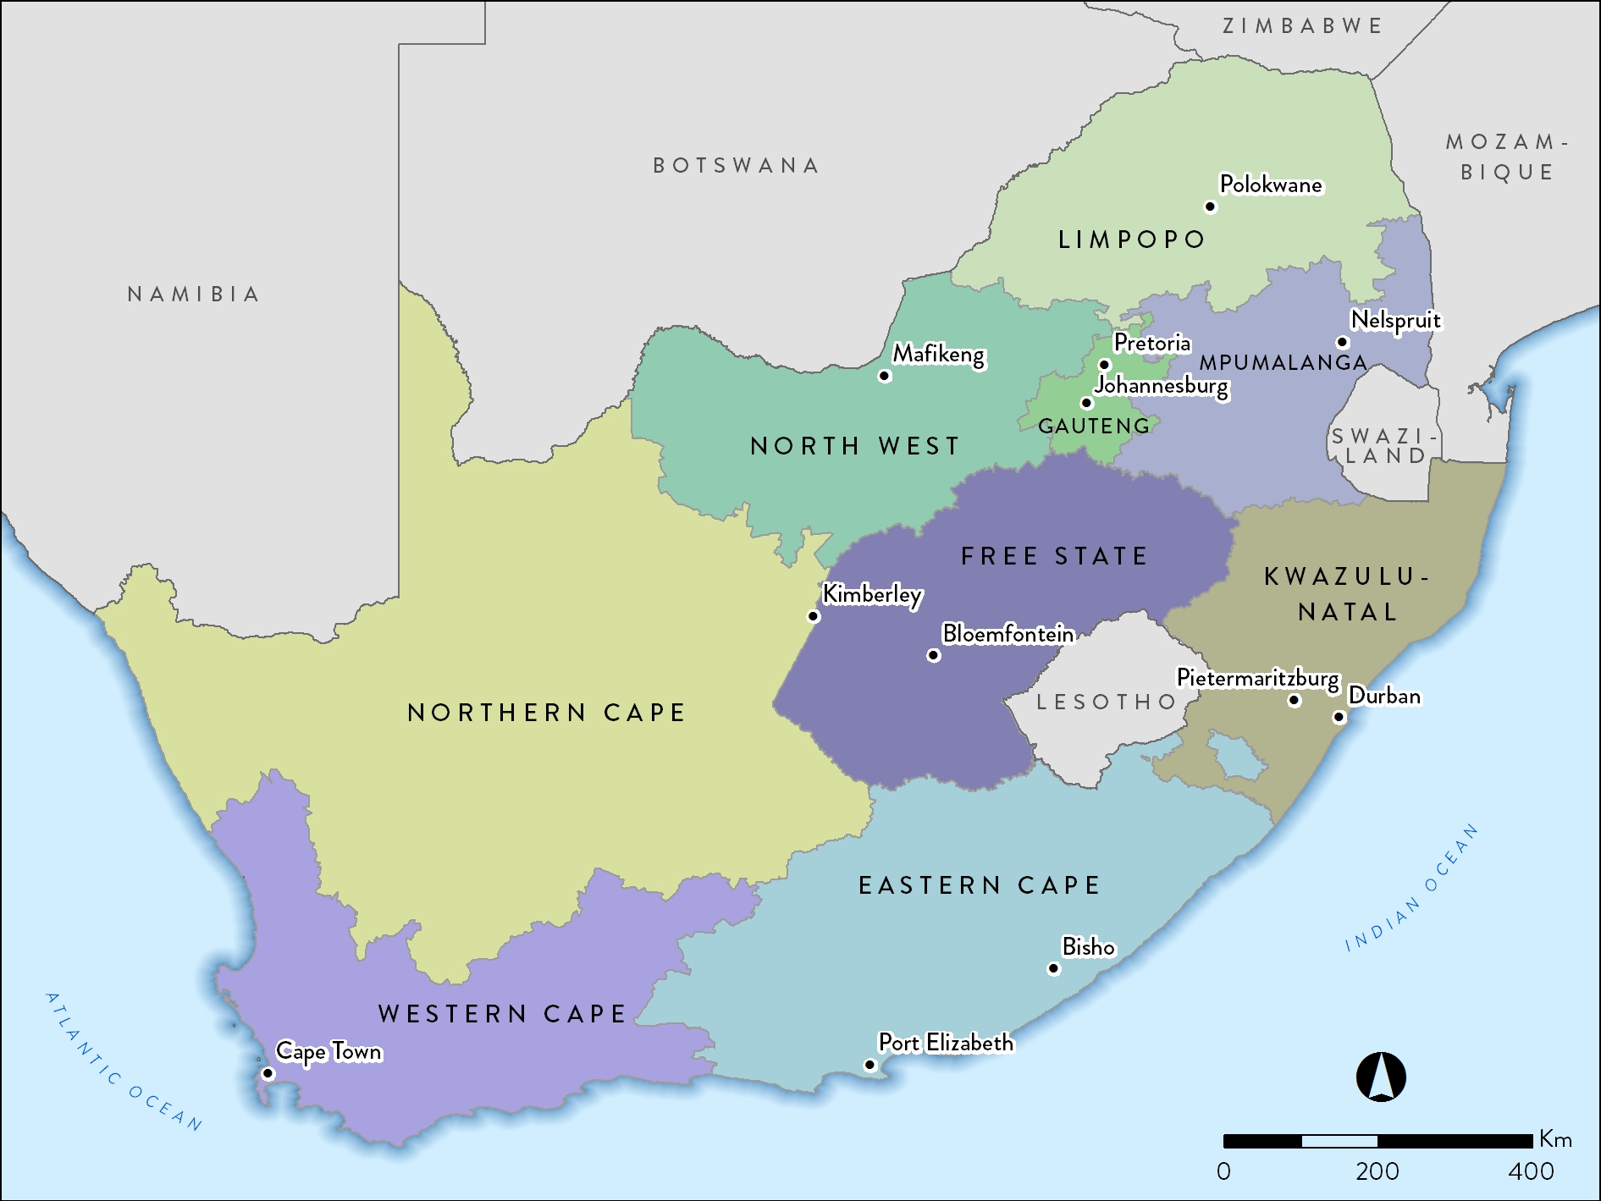
55.91 million

Slide 2
Population data by ethnic group
Population group | Million | %
Black | 45.11 | 80.7
Coloured | 4.90 | 8.8
Indian/Asian | 1.37 | 2.5
White | 4.52 | 8.1
Total | 55.91 | 100.0
Stats SA: 2016 mid-year estimates

Slide 3
Population data by province
Province | Million | %
Eastern Cape | 7.06 | 12.6
Free State | 2.86 | 5.1
Gauteng | 13.50 | 24.1
KwaZulu-Natal | 11.08 | 19.8
Limpopo | 5.80 | 10.4
Mpumalanga | 4.33 | 7.7
North West | 3.80 | 6.8
Northern Cape | 1.19 | 2.1
Western Cape | 6.29 | 11.3
Total | 55.91 | 100.0
Stats SA: 2016 mid-year estimates

Slide 4
Centres by province and sector
Sector | EC | FS | GT | KZ | LP | MP | NW | NC | WC | All
Public | 3 | 6 | 7 | 5 | 0 | 0 | 3 | 1 | 5 | 30
Private | 18 | 13 | 67 | 61 | 13 | 11 | 11 | 4 | 32 | 230
Total | 21 | 19 | 74 | 66 | 13 | 11 | 14 | 5 | 37 | 260

Slide 5
Prevalence and numbers of patients on RRT by province
Province | EC | FS | GT | KZ | LP | MP | NW | NC | WC | All
Patients | 1 045 | 577 | 3 255 | 2 022 | 409 | 275 | 465 | 146 | 2 063 | 10 257

Slide 6
RRT prevalence by healthcare sector
 | Public | Private
Population in millions | 47.03 | 8.88*
ESRD patients on treatment | 3175 | 7082
Treatment rate (pmp) | 67.5 | 797.5
* Council for Medical Schemes Annual Report 2016/17

Slide 7
Numbers of patients by province and sector
Sector | EC | FS | GT | KZ | LP | MP | NW | NC | WC | All
Public | 299 | 235 | 957 | 431 | 141 | 10 | 162 | 64 | 876 | 3 175
Private | 746 | 342 | 2 298 | 1 591 | 268 | 265 | 303 | 82 | 1 187 | 7 082
Total | 1 045 | 577 | 3 255 | 2 022 | 409 | 275 | 465 | 146 | 2 063 | 10 257

Slide 8
Prevalence of RRT by province and sector
Notes:
Adjusted for unclassified medical aid beneficiaries

Slide 9
Distribution of patients by treatment modality
13.9%
12.7%
72.7%
Modality | Patients | %
Haemodialysis | 7525 | 73.4
Peritoneal dialysis | 1307 | 12.7
Transplant | 1425 | 13.9

Slide 10
RRT modality by sector
Public
7.5%
Private
6.0%
28.1%
44.1%
86.5%
27.8%
Treatment modality | Public sector |  | Private sector
 | Patients | % | Patients | %
Haemodialysis | 1401 | 44.1 | 6124 | 86.5
Peritoneal dialysis | 881 | 27.8 | 426 | 6.0
Transplant | 893 | 28.1 | 532 | 7.5

Slide 11
New kidney transplants in 2016
 | Deceased donor |  | Living related |  | Living unrelated |  | Total
 | C | A | C | A | C | A
Western Cape - Public | 3 | 38 | 1 | 16 | 0 | 3 | 61
Western Cape - Private | 0 | 22* | 0 | 25 | 0 | 9 | 56
Gauteng - Public | 3 | 25 | 0 | 4 | 0 | 0 | 32
Gauteng - Private | 3** | 30*** | 5 | 20 | 0 | 11 | 69
KwaZulu-Natal - Public | 0 | 0 | 0 | 9 | 0 | 0 | 9
KwaZulu-Natal - Private | 1 | 11 | 0 | 10 | 0 | 3 | 25
Free State - Public | 0 | 0 | 0 | 0 | 0 | 0 | 0
Free State - Private | 0 | 0 | 0 | 2 | 0 | 0 | 2
Total | 10 | 126 | 6 | 86 | 0 | 26 | 254
C = child recipient <18 years; A= adult recipient 18 years and older.
*Includes 1 adult kidney-liver transplant **Includes 1 child kidney-liver transplant.
***Includes 2 adult kidney-liver transplants and 1 adult kidney-pancreas transplant.
The kidney transplant rate for 2016 was 4.5 pmp.
Data supplied by the SA Organ Donor Foundation.

Slide 12
RRT patient numbers and prevalence by ethnicity
Data on ethnicity available for 10 008 patients

Slide 13
Most commonly reported causes of ESRD
 | % of total
Hypertensive renal disease | 34.7
Cause unknown | 32.4
Diabetic nephropathy | 15.2
Glomerular disease | 9.9
Cystic kidney disease | 3.0
Obstruction and reflux | 1.7
Notes:
GN = 3235
HT = 3104
DM = 1273
CYSTIC = 282
UNKNOWN = 1228
OTHER = 331
Genitourinary causes = 138
Total = 9591

